Slide 1
Chapter 2 SOFTWARE DEVELOPMENT PROCESS MODELS
Total Hour:6hrs
Presented by
Er.Harendra Bikram Shah
Lecturer
Department of BCA

Slide 2
OUTLINES
Software Process Models
The Waterfall Model, Evolutionary Development, Component Based Software Engineering(CBSE), Process Iteration, Incremental Delivery, Spiral Development, Rapid Software Development, Agile Methods, Extreme Programming, Rapid Application Development and Rational Unified Process (RUP).
Overview and classification of CASE tools.
Role of CASE tools in modern software engineering practices.

Slide 3
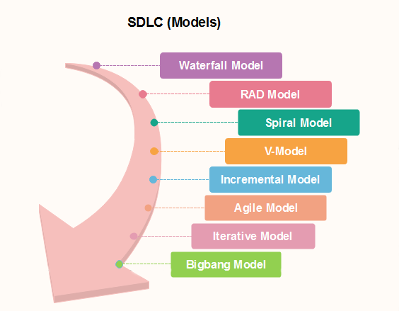
Software Development Models

Slide 4
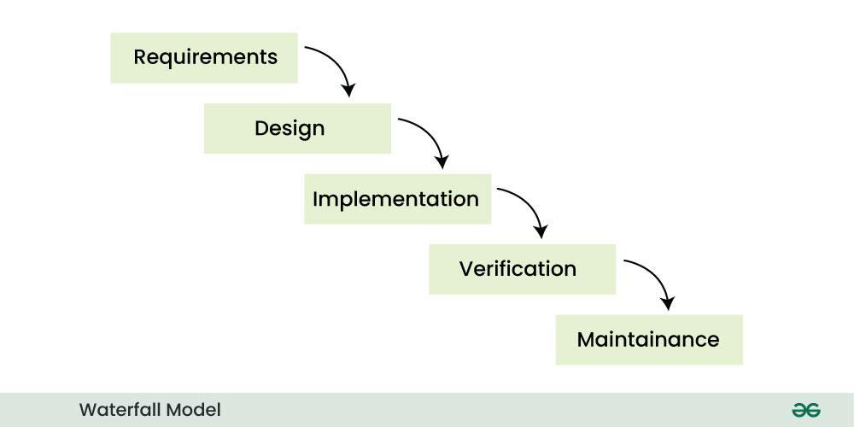
Software Development Models

Slide 5
When To Use this Model??
When the requirements are constant and not changed regularly.
A project is short
Where the tools and technology used is consistent and is not changing
When resources are well prepared and are available to use.
Advantages:
Simple and easy to understand and use.
Phases do not overlap.
Waterfall model works well for smaller projects where requirements are very well understood.
Disadvantages:
High amounts of risk and uncertainty.
Not a good model for complex projects.
Poor model for long and ongoing projects.
Not suitable for the projects where requirements are at a moderate to high risk of changing.

Slide 6
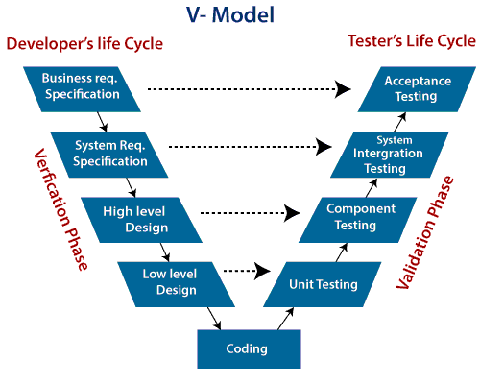
Software Development Models

Slide 7
When to use V-Model?
When the requirement is well defined and not ambiguous.
The V-shaped model should be used for small to medium-sized projects where requirements are clearly defined and fixed.
The V-shaped model should be chosen when sample technical resources are available with essential technical expertise.
Advantage :
Easy to Understand.
Testing Methods like planning, test designing happens well before coding.
This saves a lot of time
Avoids the downward flow of the defects.
Works well for small plans where requirements are easily understood.
Disadvantage :
Very rigid and least flexible.
Not a good for a complex project.
Software is developed during the implementation stage, so no early prototypes of the software are produced.
If any changes happen in the midway, then the test documents along with the required documents, has to be updated.

Slide 8
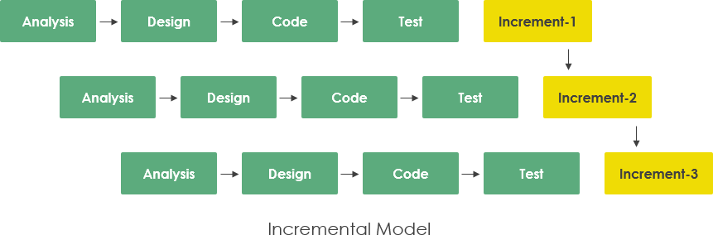
Software Development Models

Slide 9
When to use the Incremental Model?
When the requirements are superior.
A project has a lengthy development schedule.
When Software team are not very well skilled or trained.
When the customer demands a quick release of the product.
You can develop prioritized requirements first.
Advantage:
Errors are easy to be recognized.
Easier to test and debug
More flexible.
Simple to manage risk because it handled during its iteration.
The Client gets important functionality early.
Disadvantage:
Need for good planning
Total Cost is high.
Well defined module interfaces are needed.

Slide 10
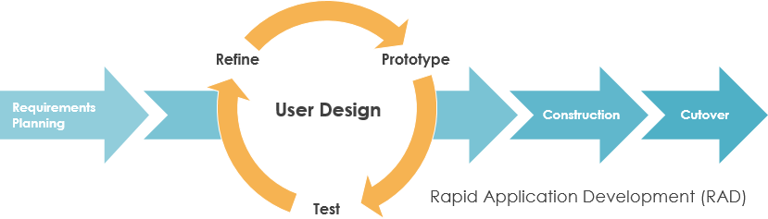
Software Development Models

Slide 11
When to use RAD Model?
When the system should need to create the project that modularizes in a short span time (2-3 months).
When the requirements are well-known.
When the technical risk is limited.
When there's a necessity to make a system, which modularized in 2-3 months of period.
It should be used only if the budget allows the use of automatic code generating tools.
Advantage of RAD Model
This model is flexible for change.
In this model, changes are adoptable.
It reduced development time.
It increases the reusability of features.
Disadvantage of RAD Model
It required highly skilled designers.
For smaller projects, we cannot use the RAD model.
On the high technical risk, it's not suitable.
Required user involvement.

Slide 12
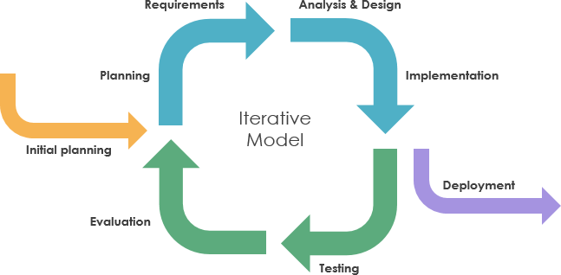
Software Development Models

Slide 13
When to use the Iterative Model?
When requirements are defined clearly and easy to understand.
When the software application is large.
When there is a requirement of changes in future.
Advantage:
Testing and debugging during smaller iteration is easy.
A Parallel development can plan.
It is easily acceptable to ever-changing needs of the project.
Risks are identified and resolved during iteration.
Limited time spent on documentation and extra time on designing.
Disadvantage:
It is not suitable for smaller projects.
More Resources may be required.
Design can be changed again and again because of imperfect requirements.
Requirement changes can cause over budget.
Project completion date not confirmed because of changing requirements.

Slide 14
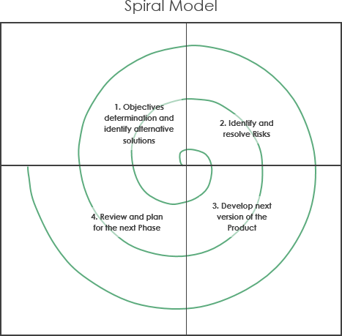

Slide 15
When to use Spiral Model?
When deliverance is required to be frequent.
When the project is large
When requirements are unclear and complex
When changes may require at any time
Large and high budget projects
Advantages
High amount of risk analysis
Useful for large and mission-critical projects.
Disadvantages
Can be a costly model to use.
Risk analysis needed highly particular expertise
Doesn't work well for smaller projects.

Slide 16
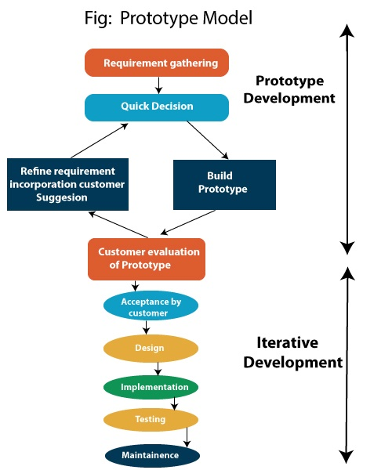

Slide 17
When to Use Prototyping Model?
Changing product requirements
Understanding the feasibility of the product
The final product requires continuous user interactions
Advantage:
Reduce the risk of incorrect user requirement
Good where requirement are changing/uncommitted
Regular visible process aids management
Support early product marketing
Reduce Maintenance cost.
Errors can be detected much earlier as the system is made side by side.
Disadvantage:
Needs committed customer
Difficult to finish if customer withdraw
Difficult to know how long the project will last.
Prototyping tools are expensive.
It is a time-consuming process.

Slide 18
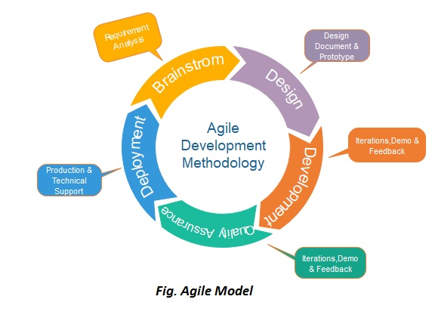
Software Development Models

Slide 19
When to use the Agile Model?
When frequent changes are required.
When a highly qualified and experienced team is available.
When a customer is ready to have a meeting with a software team all the time.
When project size is small.
Advantage:
Frequent Delivery
Face-to-Face Communication with clients.
Efficient design and fulfils the business requirement.
Anytime changes are acceptable.
It reduces total development time.
Disadvantages:
LAck of complete formal documents
Due to the lack of proper documentation, once the project completes and the developers allotted to another project, maintenance of the finished project can become a difficulty.

Slide 20
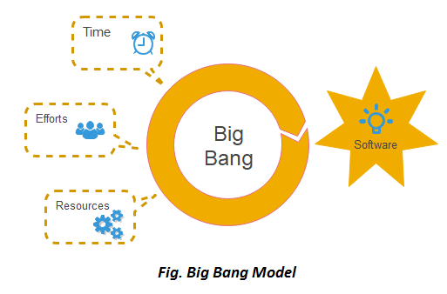
Software Development Models

Slide 21
When to use Big Bang Model?
When the project is small like an academic project or a practical project.
This method is also used when the size of the developer team is small
When requirements are not defined, and the release date is not confirmed or given by the customer.
Advantage:
There is no planning required.
Simple Model.
Few resources required.
Easy to manage.
Flexible for developers.
Disadvantage:
There are high risk and uncertainty.
Not acceptable for a large project.
If requirements are not clear that can cause very expensive.

Slide 22
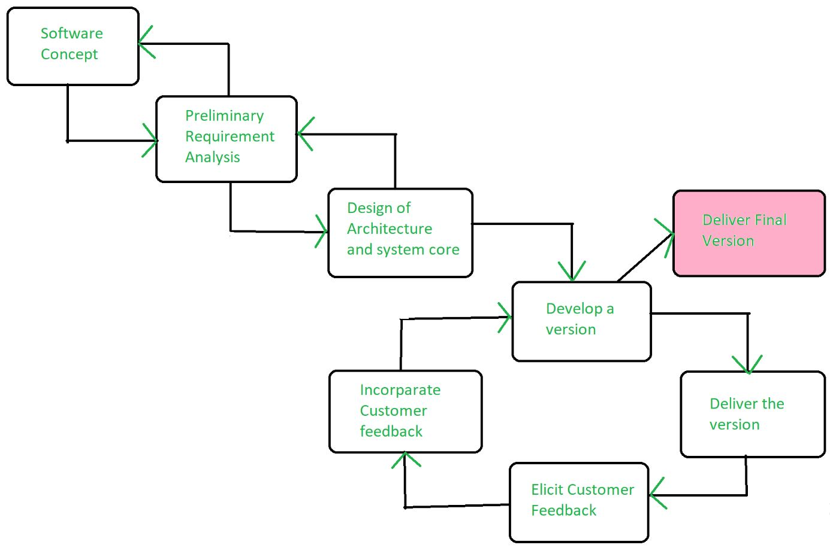
EVOLUTIONARY MODEL IN SOFTWARE ENGINEERING
combination of the Iterative and Incremental waterfall model of the software development life cycle.
model that divides the development cycle into smaller, incremental waterfall models in which users can get access to the product at the end of each cycle.

Slide 23
EVOLUTIONARY MODEL IN SOFTWARE ENGINEERING
Application of Evolutionary Model
used in large projects where the customer wants to start using the core features instead of waiting for the full software.
used in object oriented software development because the system can be easily portioned into units in terms of objects.
Necessary Conditions for Implementing this Model
Customer needs are clear and been explained in deep to the developer team.
There might be small changes required in separate parts but not a major change.
As it requires time, so there must be some time left for the market constraints.
Risk is high and continuous targets to achieve and report to customer repeatedly.
It is used when working on a technology is new and requires time to learn.

Slide 24
EVOLUTIONARY MODEL IN SOFTWARE ENGINEERING
Advantages Evolutionary Model
Adaptability to Changing Requirements
Early and Gradual Distribution
User Commentary and Involvement
Improved Handling of Difficult Projects
Disadvantages Evolutionary Model
Communication Difficulties
Dependence on an Expert Group
Increasing Management Complexity
Greater Initial Expenditure

Slide 25
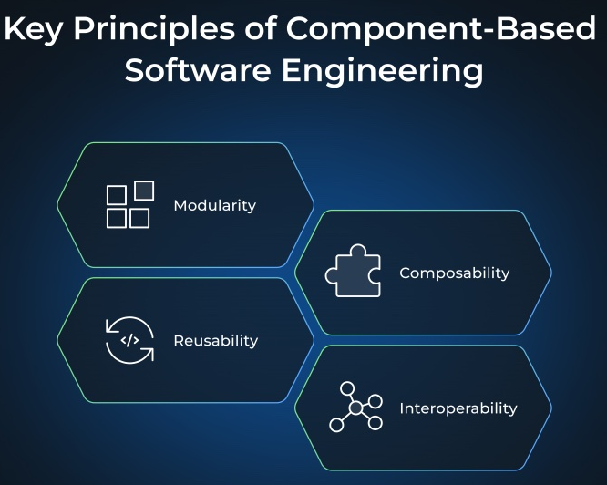
COMPONENT BASED SOFTWARE ENGINEERING

Slide 26
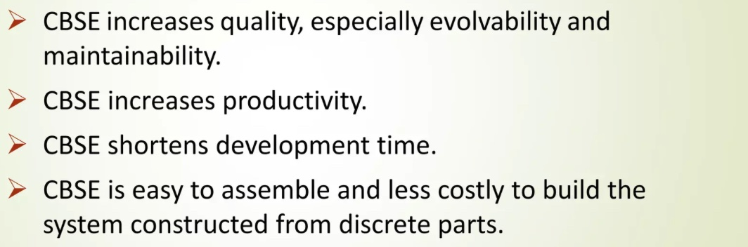
WHY COMPONENT BASED SOFTWARE ENGINEERING??

Slide 27
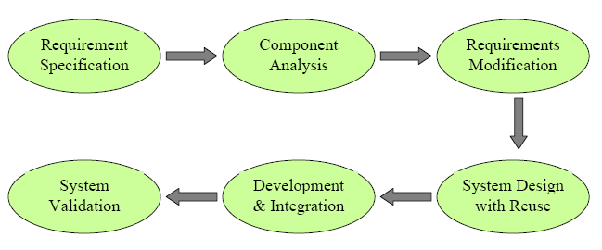
PHASES OF COMPONENT BASED SOFTWARE ENGINEERING

Slide 28
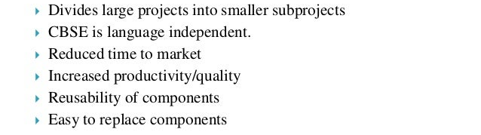
ADVANTAGES OF COMPONENT BASED SOFTWARE ENGINEERING

Slide 29
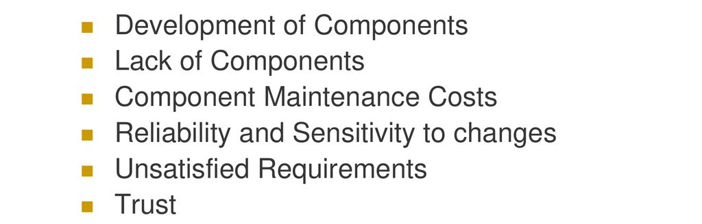
DISADVANTAGES OF COMPONENT BASED SOFTWARE ENGINEERING

Slide 30
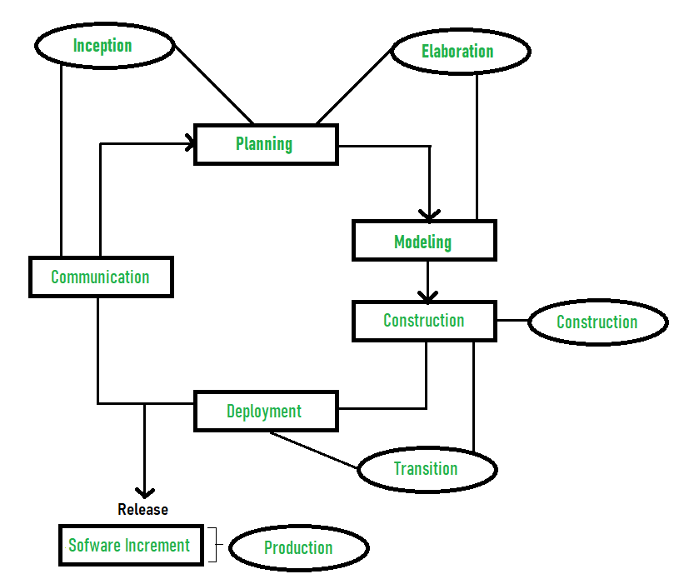
Rational Unified Process (RUP)
It is a framework for software engineering processes.
RUP is an Iterative and incremental approach to improving problem knowledge through consecutive revisions.
RUP is proposed by Ivar Jacobson, Grady Bootch, and James Rambaugh.

Slide 31
Rational Unified Process (RUP)
Advantages of Rational Unified Process (RUP)
RUP provides good documentation, it completes the process in itself.
RUP provides risk-management support.
RUP reuses the components, and hence total time duration is less.
Good online support is available in the form of tutorials and training.
Disadvantages of Rational Unified Process (RUP)
Team of expert professional is required, as the process is complex.
Complex and not properly organized process.
More dependency on risk management.
Hard to integrate again and again.

Slide 32
Agile Software Development
Agile Software Development is an iterative and incremental approach to Software development that emphasizes the importance of delivering a working product quickly and frequently.
It involves close collaboration between the development team and the customer to ensure that the product meets their needs and expectations.
Why Agile is Used?
Creating Tangible Value:
Concentrate on Value-Added Work:
Agile as a Mindset:
Quick Response to Change:
Regular Demonstrations:
Cross-Functional Teams:

Slide 33
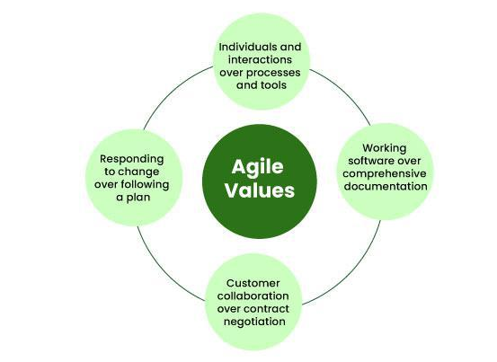
4 Core Values of Agile Software Development

Slide 34
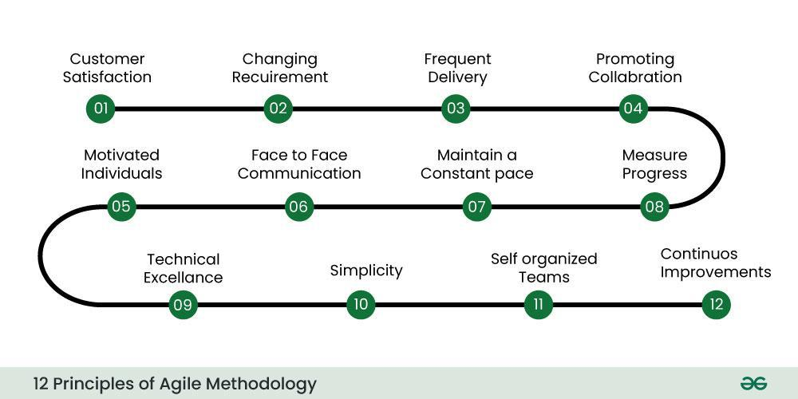
12 Principles of Agile Software Development

Slide 35
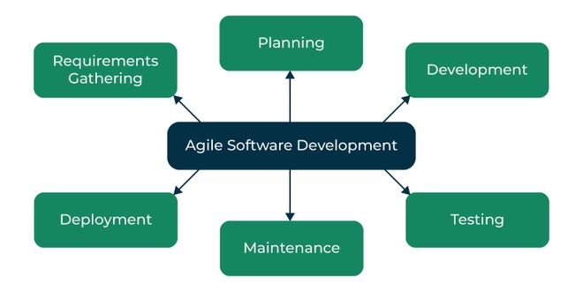
Agile Software Development Process

Slide 36
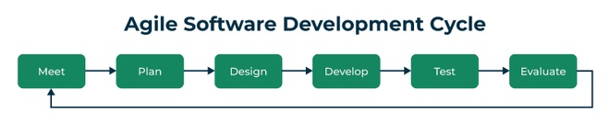
Agile Software development cycle
Agile philosophy.
concept
inception
iteration/construction
release
production
retirement

Slide 37
Advantages of Agile Software Development over traditional software development approaches
Increased customer satisfaction:
Faster time-to-market:
Reduced risk:
Improved team collaboration:
Adaptability to change:
Better quality software:
Increased transparency:
Higher productivity:
Improved project control:

Slide 38
Types of Agile Methodology
1.Scrum: Framework that involves iterative cycles called sprints, daily stand-up meetings, and a product backlog that is prioritized by the customer.
2.Kanban: It is a visual system that helps teams manage their work and improve their processes. It involves using a board with columns to represent different stages of the development process, and cards or sticky notes to represent work items.
3.Extreme Programming (XP):It focuses on technical practices and rapid delivery.
4.Adaptive Project Framework (APF):It is designed for projects where things can change unexpectedly.
5.Dynamic Systems Development Method (DSDM):It is more structured and covers the entire project lifecycle.
6. Feature Driven Development (FDD):It focuses on developing specific features.

Slide 39
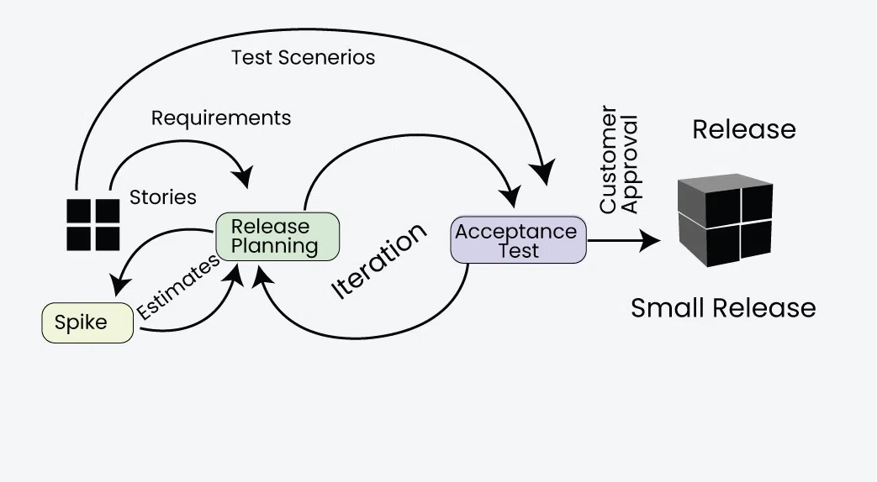
EXTREME PROGRAMMING (XP)
Focuses on delivering high-quality software through frequent and continuous feedback, collaboration, and adaptation.
XP emphasizes a close working relationship between the development team, the customer, and stakeholders, with an emphasis on rapid, iterative development and deployment.

Slide 40
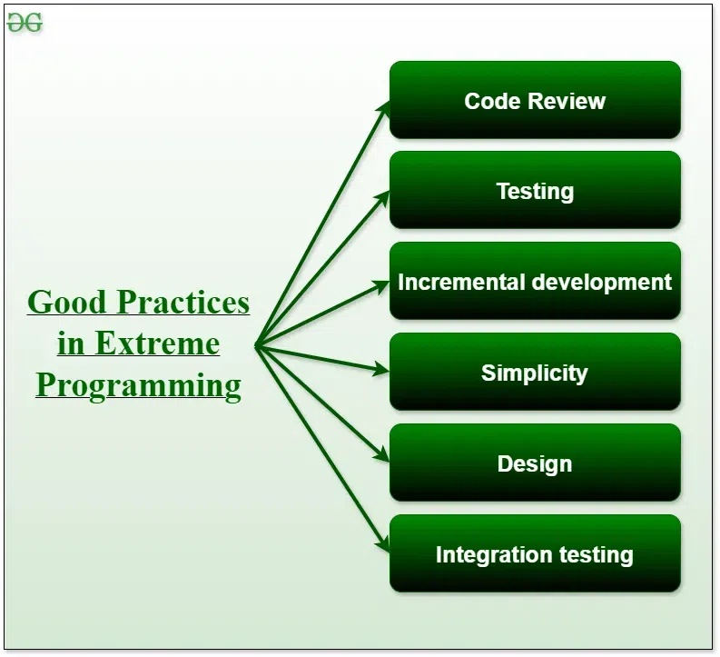
Good Practices in Extreme Programming

Slide 41
Principles of Extreme Programming
Coding: drawing diagrams (modeling) that will be transformed into code, scripting a web-based system
Testing: The XP model gives high importance to testing and considers it to be the primary factor
Listening: The developers need to carefully listen to the customers if they have to develop good quality software.
Designing: A good design results elimination of complex dependencies within a system
Feedback: gain feedback to understand the exact customer needs.
Simplicity: The main principle of the XP model is to develop a simple system that will work efficiently in the present time
Pair Programming: XP encourages pair programming where two developers work together at the same workstation.
Continuous Integration: In XP, developers integrate their code into a shared repository several times a day.
Refactoring: XP encourages the process of restructuring existing code to make it more efficient and maintainable.
Collective Code Ownership: the entire team is responsible for the codebase.
Planning Game: the customer and the development team collaborate to prioritize and plan development tasks.
On-site Customer: XP requires an on-site customer who works closely with the development team throughout the project.

Slide 42
Applications of Extreme Programming (XP)
Some of the projects that are suitable to develop using the XP model are given below:
Small projects:
Projects involving new technology or Research projects:
Web development projects:
Collaborative projects:
Projects with tight deadlines:
Projects with rapidly changing requirements:
Projects where quality is a high priority:

Slide 43
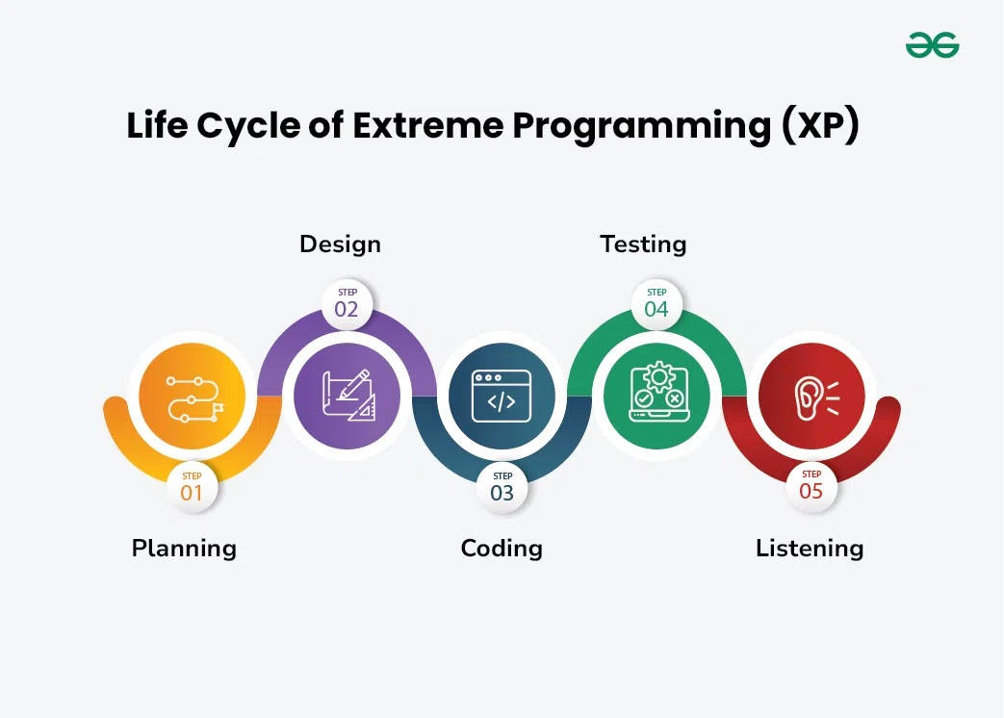

Slide 44
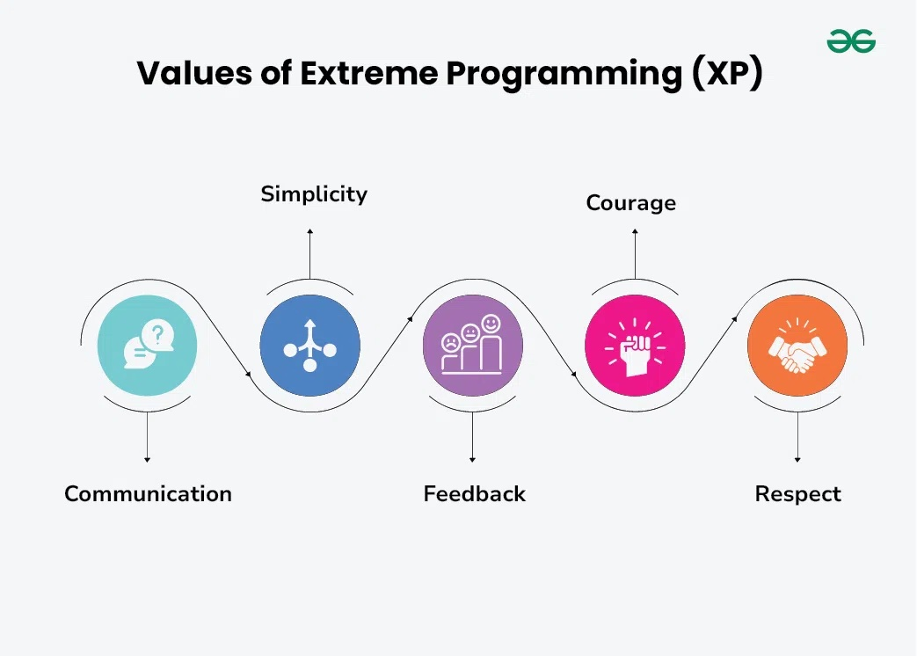

Slide 45
Advantages of Extreme Programming (XP)
Slipped schedules:
No Misunderstanding the business and/or domain
Cancelled projects:
Staff turnover:
Costs incurred in changes:
Business changes:
Production and post-delivery defects:

Slide 46
Agile Project Management
Agile Project Management:
iterative and flexible approach to managing projects, initially popularized in software development but now used across various industries.
Agile emphasizes delivering value quickly, adapting to changes, and continuously improving through collaboration among cross-functional teams.
Core Principles of Agile Project Management
The Agile approach is built on principles outlined in the Agile Manifesto, which emphasizes:
Individuals and interactions over processes and tools.
Working software (or product) over comprehensive documentation.
Customer collaboration over contract negotiation.
Responding to change over following a fixed plan.
Benefits of Agile Project Management:
Faster time to market:
Improved customer satisfaction:
Increased flexibility:
Higher quality:
Enhanced team morale:

Slide 47
Agile Project Management and Scaling Agile Methods
Challenges of Agile:
Cultural shift: Adopting Agile requires a change in mindset and organizational culture.
Skill development: Teams need training and coaching to effectively implement Agile practices.
Measuring success: Traditional metrics may not be suitable for Agile projects.
Managing dependencies: In large-scale projects, coordinating dependencies can be complex.

Slide 48
Pros and Cons of Process Models and their Applicability
Pros and Cons of Process Models
Pros:
Structure and Organization:
Risk Management:
Quality Assurance:
Team Collaboration:
Customer Satisfaction:
Cons:
Rigidity:
Overemphasis on Documentation:
Limited Adaptability:
Complexity:

Slide 49
Applicability of Process Models
Applicability of Process Models:
The choice of a process model depends on various factors, including:
Project Size and Complexity:
Requirement Certainty:
Customer Involvement:
Risk Tolerance:
Team Experience and Maturity:

Slide 50
OVERVIEW AND CLASSIFICATION OF CASE TOOLS
CASE stands for Computer Aided Software Engineering which is software that supports one or more software engineering activities within a software development process.
CASE Tools are In-built programs can help to analyze developing systems in order to enhance quality and provide better outcomes.
Role of CASE tools:
Project management
Code generation
User interface design
Schema generation
Creation of meta-data for data warehouse
Document generation
OO analysis and design
Software testing
Project scheduling
Cost estimation

Slide 51
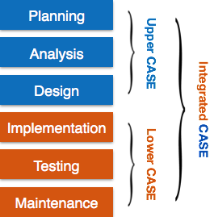
Types of CASE Tool

Slide 52
Types of CASE Tool
Diagramming Tools: It helps in diagrammatic and graphical representations of the data and system processes
Computer Display and Report Generators: These help in understanding the data requirements and the relationships involved.
Analysis Tools:
Central Repository: It provides a single point of storage for data diagrams, reports, and documents related to project management.
Documentation Generators: It helps in generating user and technical documentation as per standards.
Code Generators: It aids in the auto-generation of code, including definitions, with the help of designs, documents, and diagrams.
Tools for Requirement Management: It makes gathering, evaluating, and managing software needs easier.
Tools for Analysis and Design: It offers instruments for modelling system architecture and behaviour, which helps throughout the analysis and design stages of software development.
Tools for Database Management: It facilitates database construction, design, and administration.
Tools for Documentation: It makes the process of creating, organizing, and maintaining project documentation easier.

Slide 53
Characteristics of a successful CASE Tool
A standard methodology:
Flexibility:
Strong Integration:
Integration with testing software:
Support for reverse engineering:
On-line help:

Slide 54
Advantages of the CASE approach:
Improved Documentation:
Reusing Components:
Quicker Cycles of Development:
Improved Results:
Achieving uniformity and standardization:
Disadvantages of the CASE approach:
Cost:
Learning Curve:
Tool Mix:

Slide 55
CASE Tool Type | Purpose | Example
Upper CASE | Planning and Design | Rational Rose, Lucidchart
Lower CASE | Coding, Testing, Maintenance | Selenium, JUnit
Integrated CASE | Full SDLC support | Visual Studio, OutSystems
Purpose | Example Tools
Requirement Management | IBM DOORS, Jama Connect
Modeling and Diagramming | Lucidchart, Draw.io
Code Generation | GenMyModel, Codebots
Version Control | Git, Subversion (SVN)
Project Management | Jira, Trello, Asana
Testing | Selenium, TestComplete, LoadRunner
Documentation | Doxygen, Sphinx

Slide 56
ROLE OF CASE TOOLS IN MODERN SOFTWARE ENGINEERING PRACTICES.
1. Enhancing Productivity
2. Improving Software Quality
3. Standardization
4. Supporting Project Management
5. Facilitating Better Communication
6. Assisting in Requirements Management
7. Boosting Reusability
8. Supporting Maintenance and Evolution

Slide 57
End of The End

Slide 58
THANK YOU

